Slide 1
JOINS

Slide 2
JOIN
INNER
CROSS
OUTER
LEFT OUTER
RIGHT OUTER

Slide 3
JOIN
A JOIN clause is used to combine rows from two or more tables, based on a related column between them.
Syntax:
SELECT column-names
FROM table-name1 JOIN table-name2
ON column-name1 = column-name2
WHERE condition

Slide 4
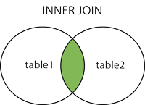
Inner Join
The INNER JOIN keyword selects records that have matching values in both tables.
An SQL INNER JOIN is same as JOIN clause, combining rows from two or more tables.

Slide 5
Syntax:
SELECT column_name(s) FROM table1 INNER JOIN table2 ON table1.column_name = table2.column_name;

